Slide 1
FYE: Sports Analytics Lecture 1: What is sports and statistics?

Slide 2
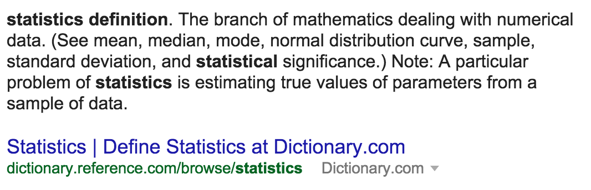
What is statistics?
Bad definition:
ii) Better definition:
‘Science of learning from data’ – Marie Davidian

Slide 3
What is statistics in sports?
‘Science of learning from data’ in sports
1) Wrangle & visualize data
2) Statistical tool
- Ex: Regression, t-test, etc
3) Measure uncertainty
- Practical vs. statistical significance
4) Communicate results
- Appropriate generalizability
What am I missing?

Slide 4
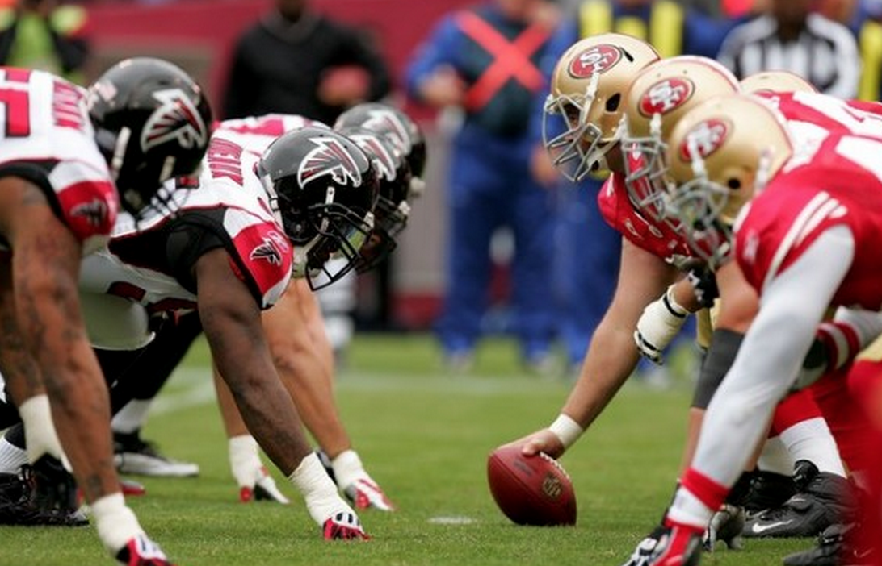
Wrangle data
Start with:

Slide 5
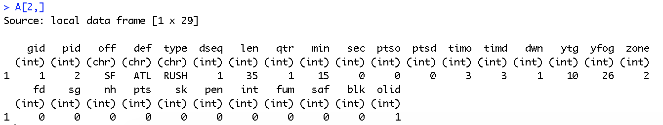
Wrangle data
End with:

Slide 6
What should good data look like?

Slide 7
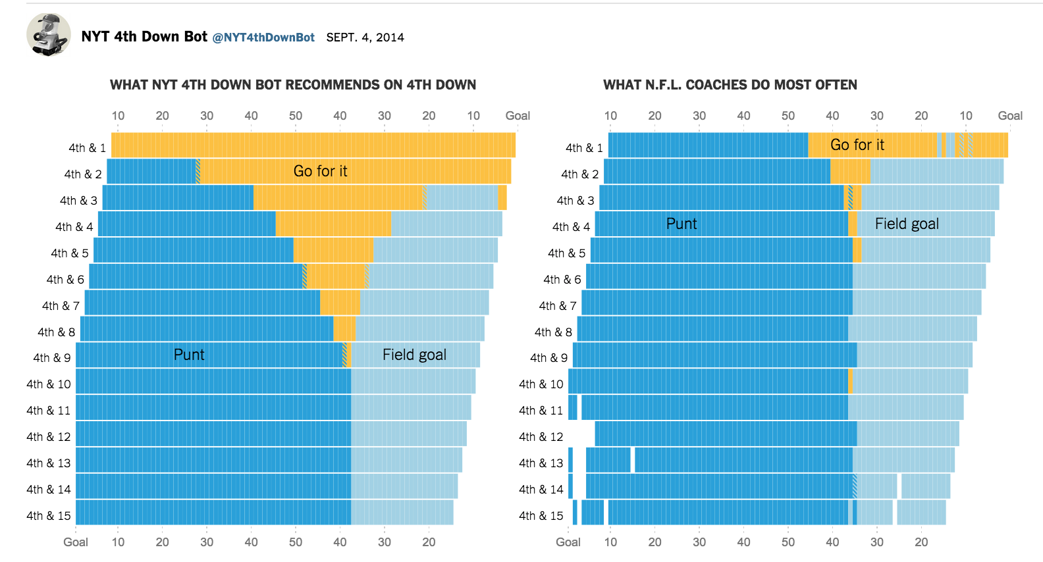
Visualizing data

Slide 8
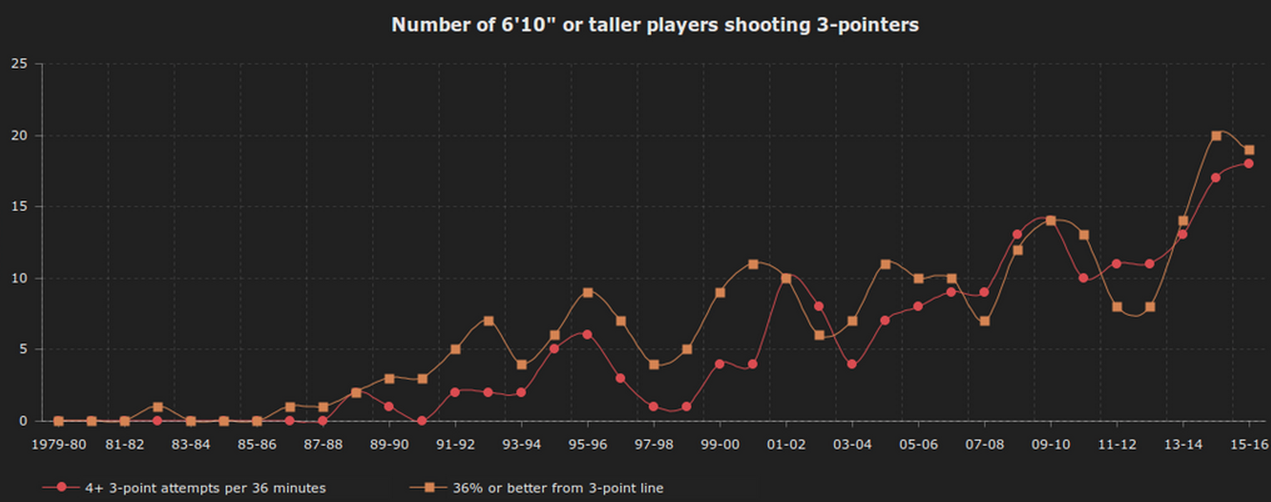
Visualizing data
http://nyloncalculus.com/2016/01/12/torontos-power-forwards-firing-away-corners/

Slide 9
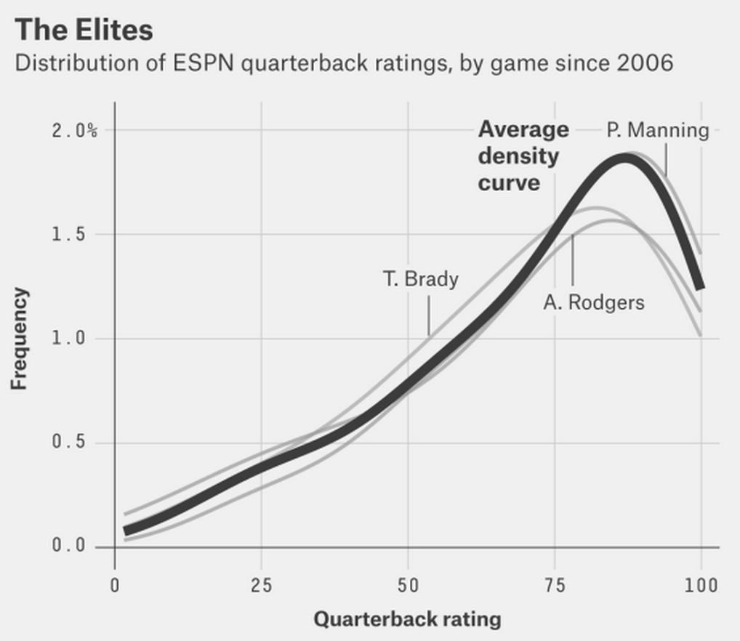
Visualizing data
http://fivethirtyeight.com/features/the-10-types-of-nfl-quarterbacks/

Slide 10
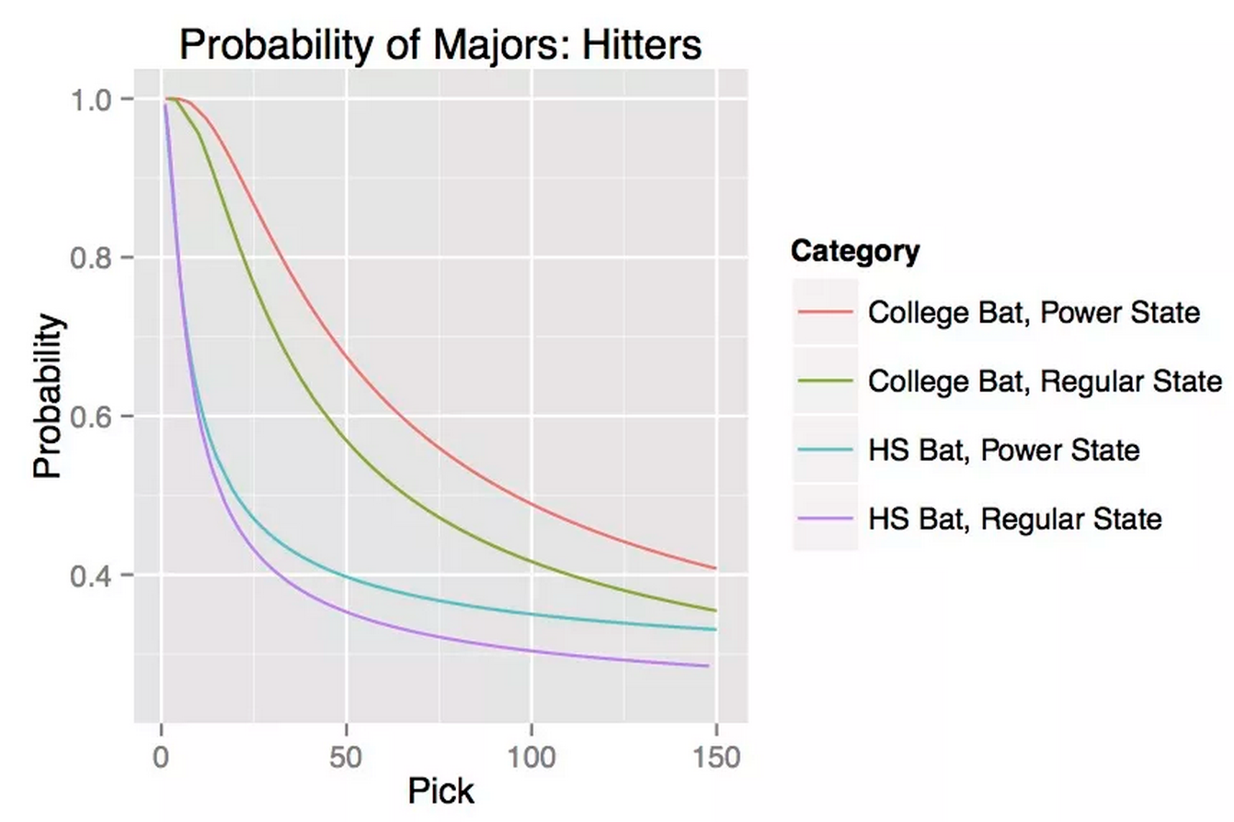
Statistical tool
http://www.beyondtheboxscore.com/2015/3/23/8269695/geographic-bias-in-the-amateur-draft-part-2-1

Slide 11
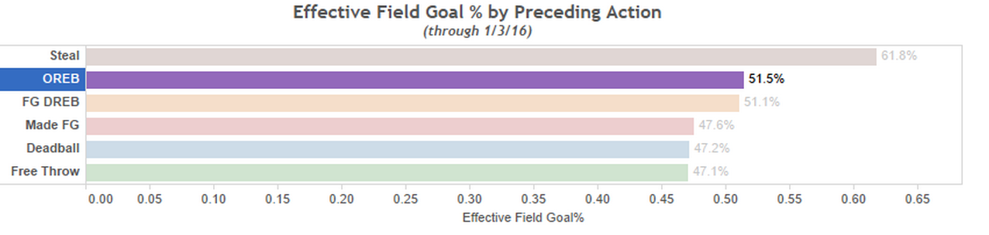
Statistical tool
http://nyloncalculus.com/2016/01/06/offensive-rebounds-and-three-pointers/

Slide 12
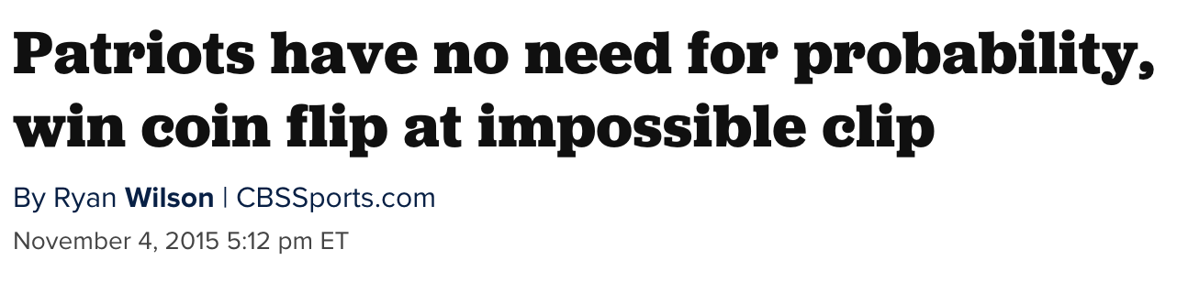
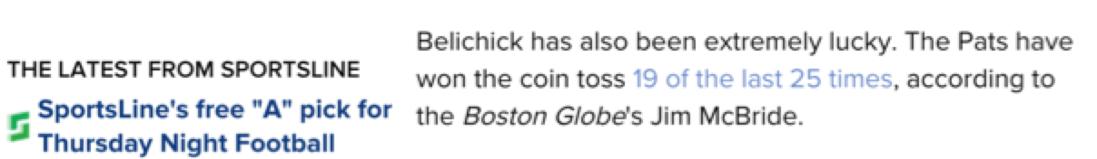
Statistical tool
www.cbssports.com/nfl/eye-on-football/25363570/patriots-have-no-need-for-probability-win-coin-flip-at-impossible-clip

Slide 13
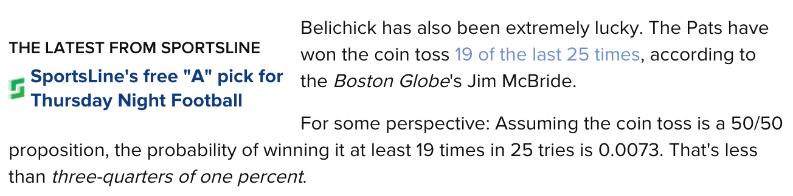
Statistical tool, account for uncertainty

Slide 14
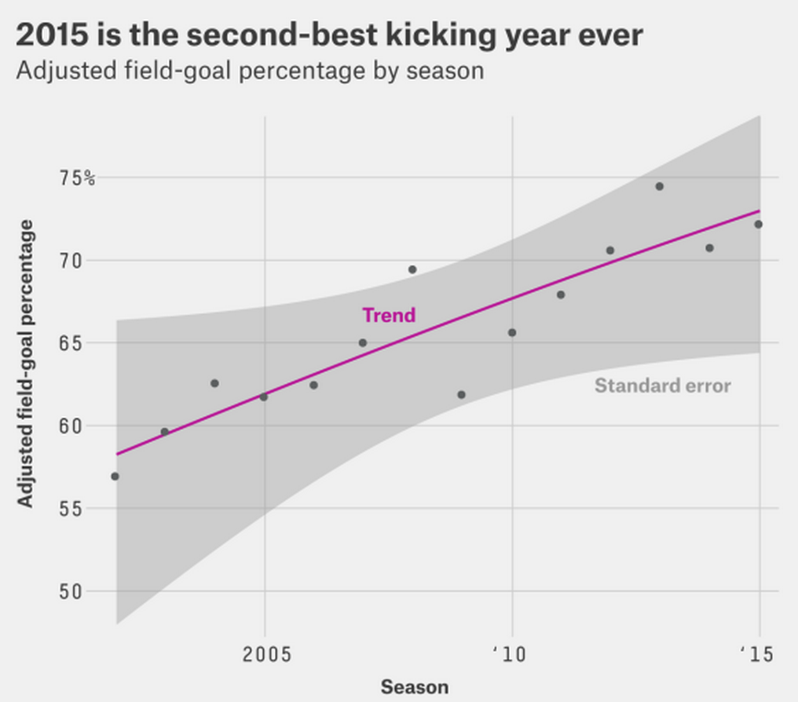
Statistical tool, account for uncertainty
http://fivethirtyeight.com/features/the-haters-are-losing-the-war-on-nfl-kickers/

Slide 15

Significance: statistical? practical?

Slide 16
Generalizability? Who? Where? When?

Slide 17
Definitions
Statistical significance:
Practical significance:
Generalizability:

Slide 18
Rough history of statistics in sports
Jamesian era (1970’s – 2004ish)
- Hey, you can apply statistics to sports!
Modern era (2004ish – current)
- Get more data, do cool stuff
- Get more data, do really cool stuff, get hired
- Let’s call ourselves sports analytics because it’s sexier
Future (Current - ????)
- Get more data only if you work for a sports team
- Holy shit, now there may be too much data

Slide 19

Jamesian era
Bill James Baseball Abstract, 1977
“Stein’s Paradox in Statistics” – 1977, Efron and Morris
“On the optimal time to pull the goalie” – 1976, Morrisonn
“Operations research in football” – Carter & Machol, 1971

Slide 20

Jamesian era

Slide 21


Modern era
“Get more data, do cool stuff”

Slide 22
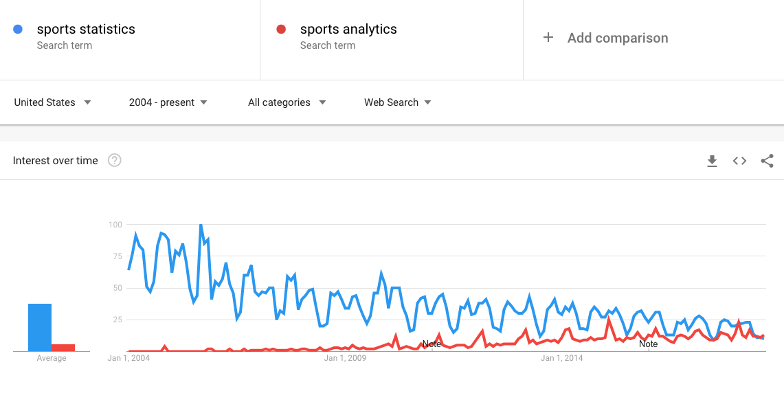
Modern era
Sports and statistics becomes sports analytics

Slide 23
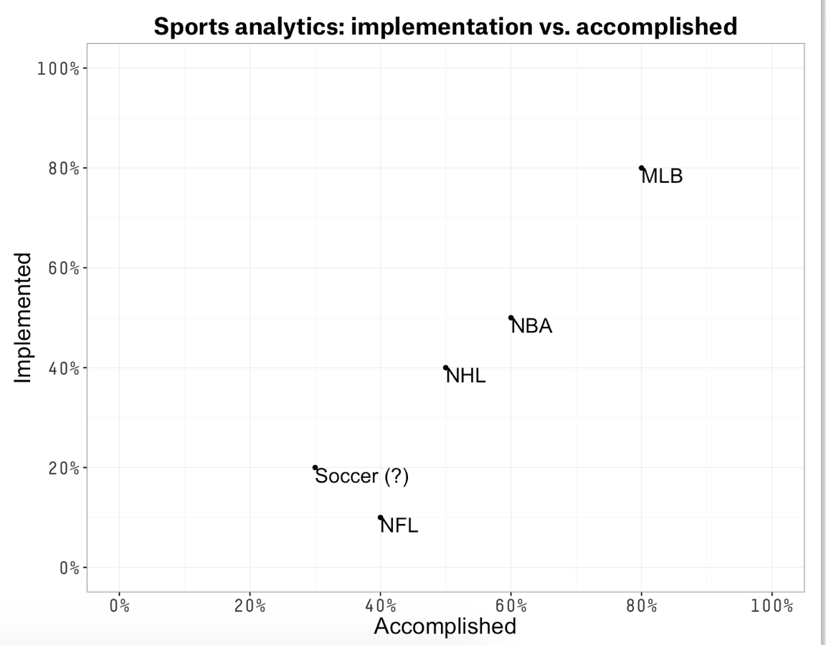
Modern era
Where do we stand? One man’s opinion (mine)

Slide 24
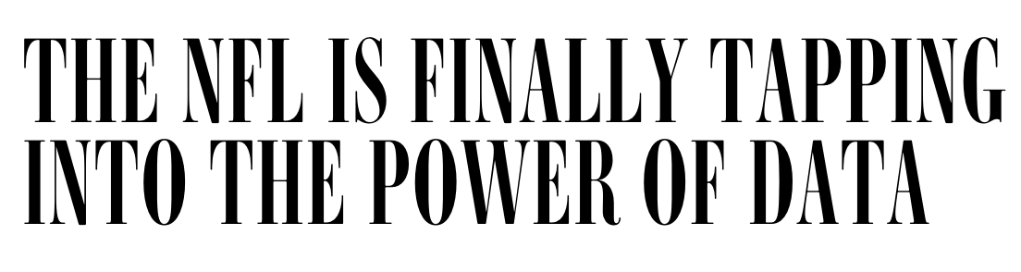
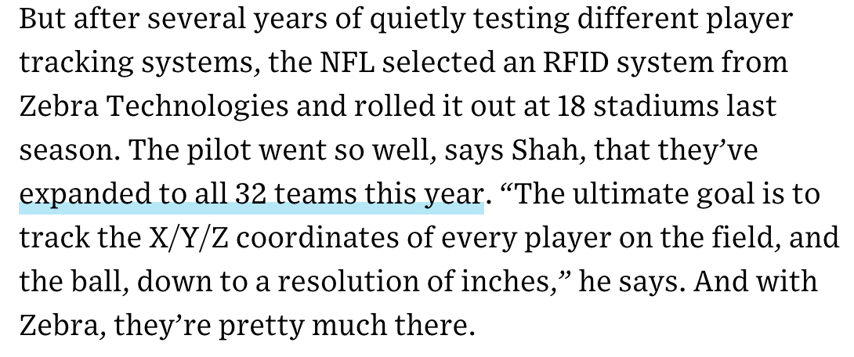
Future era
“Holy shit, we have too much data”

Slide 25
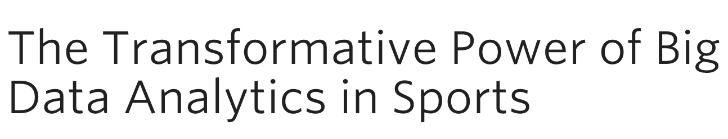
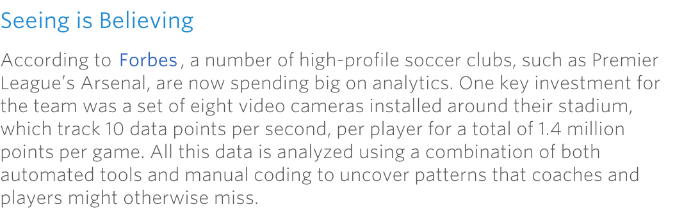
Future era
“Holy shit, we have too much data”

Slide 26
Where do we fit in?
-Gain an understanding of how statistical tools have been applied in the sports world
-Learn methods for analysis, visualization, and implementation
-Gain familiarity statistical tools
-Skills for communication and problem solving

